Slide 1

BMW Global Sales Analysis
Data SQL Project (2010-2024)
Presented by: Himadree

Slide 2
About BMW
BMW (Bayerische Motoren Werke AG) is a globally recognized leader in the premium automotive sector, renowned for its engineering excellence, luxury, and performance. Operating on a vast international scale, the company continually adapts to shifting global markets, fluctuating economic conditions, and the rapid transition toward sustainable, electrified mobility

Slide 3
Project Overview
This project is dedicated to a comprehensive analysis of global automotive sales data for BMW spanning from 2010 to 2024. By scrutinizing thousands of vehicle sales records, we explored various car models, fuel types, and transmission configurations to identify trends and factors that influence regional sales performance.

Slide 4
Business Challenge
BMW is seeking to optimize its global sales strategies and regional market targeting across its key international markets. The objective is to delve deep into 14 years of historical sales data to identify which vehicle models, fuel types (specifically the emerging Electric Vehicle sector), and transmission configurations are yielding the highest profitability and volume. By thoroughly analyzing long-term automotive sales trends, BMW aims to develop more refined business strategies to tailor regional marketing approaches, optimize global manufacturing, and drive significant growth.

Slide 5
AD-HOC Requests

Slide 6
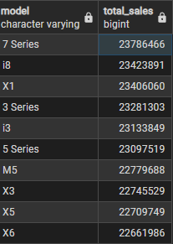
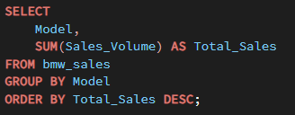
Sales Volume by Model
Objective: Top 5 Regions by Total Sales.
OUTPUT
OUTPUT

Slide 7
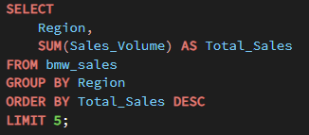
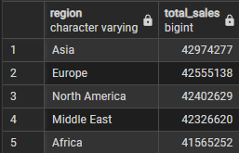
Top 5 Regions
Objective: Top 5 Regions by Total Sales.
OUTPUT

Slide 8
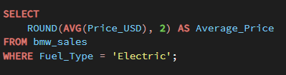

Average Price of Electric Vehicles
Objective: Average Price of Electric BMWs.
OUTPUT

Slide 9
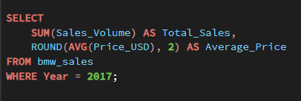

Sales in a Specific Year
Objective: Total Sales and Average Price in 2017.
OUTPUT

Slide 10
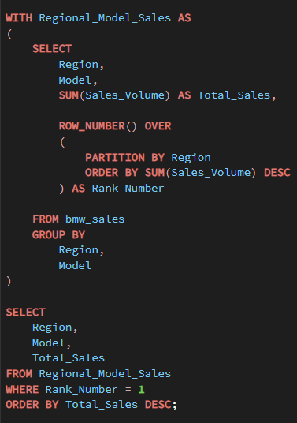
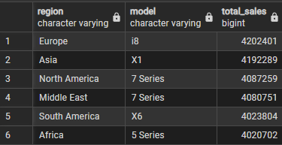
High-Volume Models by Region
Objective: Best Selling BMW Model in Each Region.
OUTPUT

Slide 11
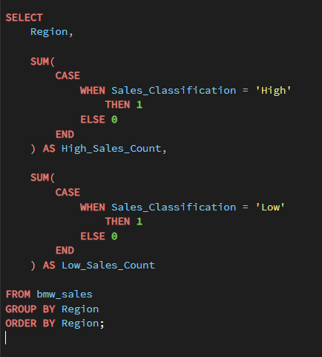
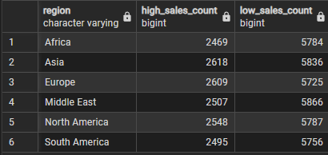
Sales Classification Distribution
Objective: High vs Low Sales Classification by Region.
OUTPUT

Slide 12
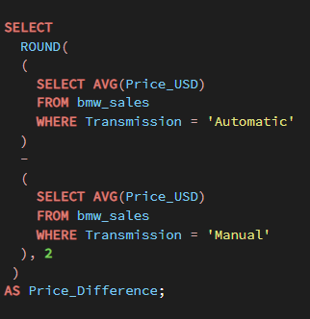

Price Difference between Transmission Types
Objective: Price Difference Between Automatic and Manual BMWs.
OUTPUT

Slide 13
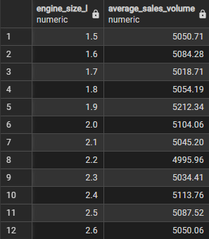
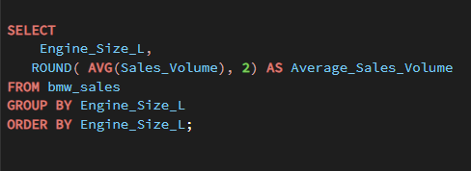
Correlation between Engine Size and Sales
Objective: Average Sales Volume by Engine Size.
OUTPUT

Slide 14
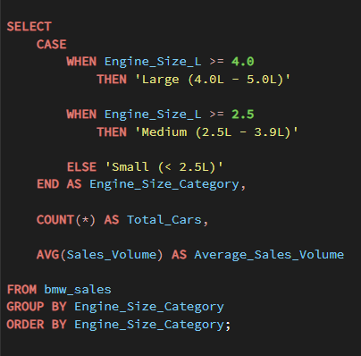
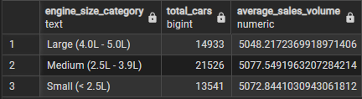
Depreciation Analysis (Categorized by Engine Size)
Objective: Engine Size Category Analysis.
OUTPUT

Slide 15
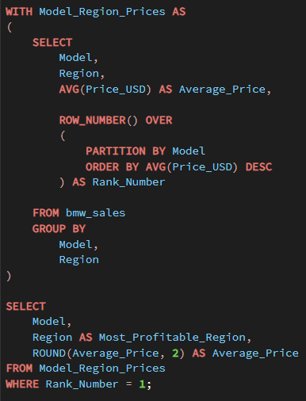
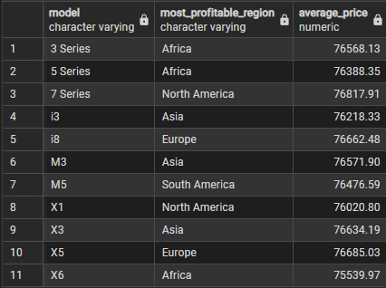
Most Profitable Region per Model
Objective: Most Profitable Region for Each BMW Model.
OUTPUT

Slide 16
Conclusion & Recommendations
The SQL analysis of 14 years of historical BMW data reveals clear pathways to optimize sales strategy. High-volume models vary vastly across borders—while the i8 commands the highest volume in Europe, the X1 dominates Asia, meaning regional inventory allocations must remain hyper-localized rather than standardized. Furthermore, Electric Vehicles now command a competitive baseline market premium globally (~$75,276), paving the way for confident marketing of upcoming EV models. By tailoring supply chains to match localized consumer preferences, BMW can effectively increase margins and decrease dormant inventory.

Slide 17
Thank you!

